Slide 1
Predicting Appliance Energy Consumption in Households
Omkar Narayan Naik
12-03-2025

Slide 2
Agenda
Introduction
Data Collection
Exploratory Data Analysis (EDA) And Visualization
Data Preprocessing
Machine Learning Model Development
Model Evaluation

Slide 3
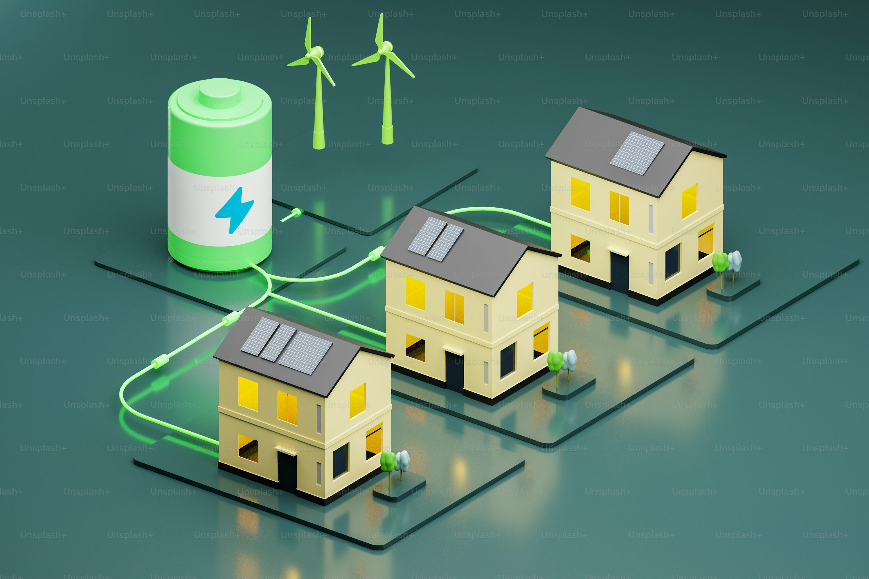
Predicting Appliance Energy Consumption in Households
Project Introduction
Objective: Develop a machine learning model to predict appliance energy consumption.
Importance: Helps optimize energy usage, reduce costs, and improve efficiency.
Approach: Data preprocessing, feature engineering, model selection, evaluation, and optimization.

Slide 4

Dataset Overview
Dataset Name: energydata_complete.csv
Number of Rows: 19,735
Number of Features: 29
Target Variable: Appliances (Energy Consumption in Wh)
Key Features: Temperature, Humidity, Date-Time Information, and Weather Conditions

Slide 5
The Project Workflow

Slide 6
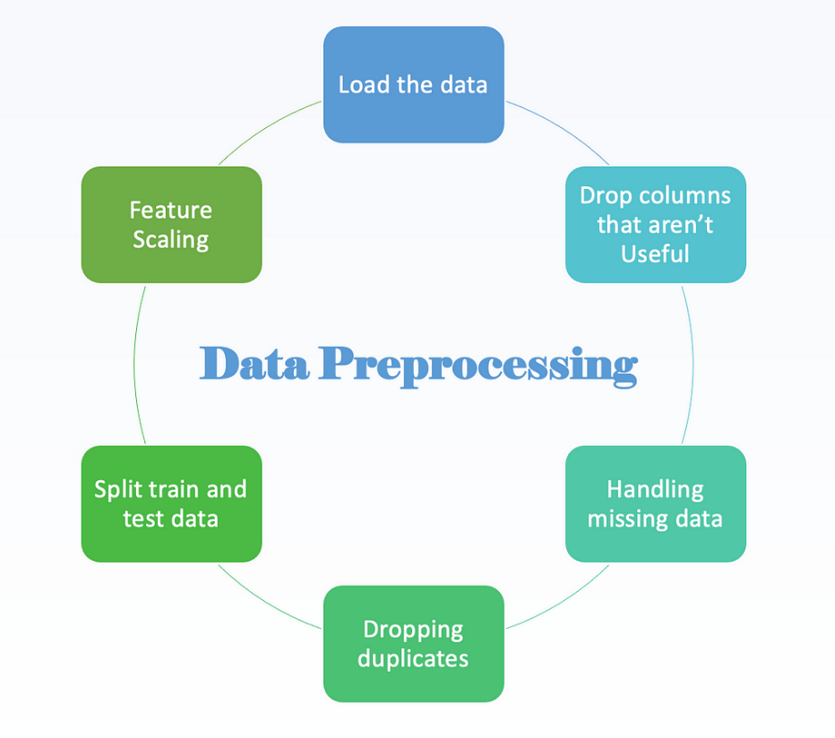
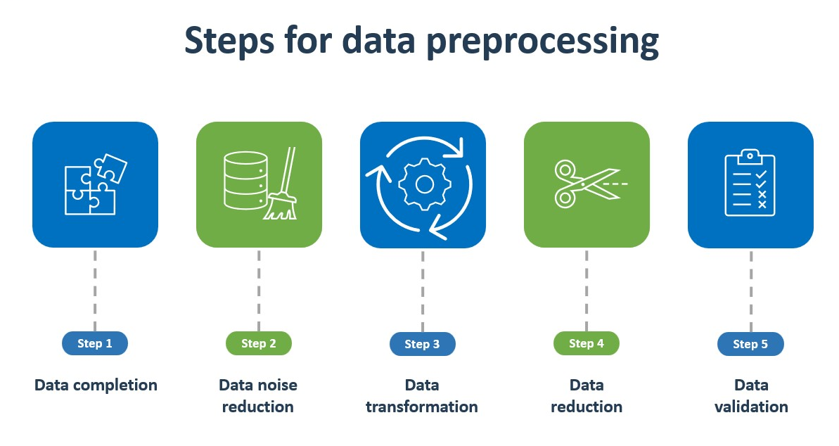
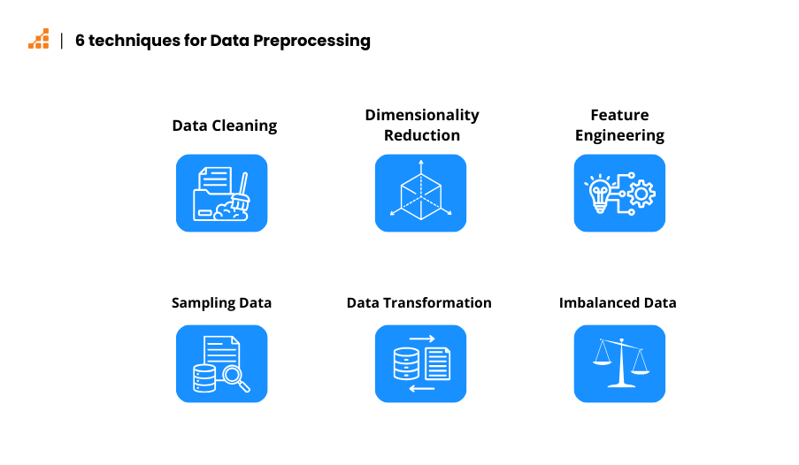
Data Preprocessing

Slide 7
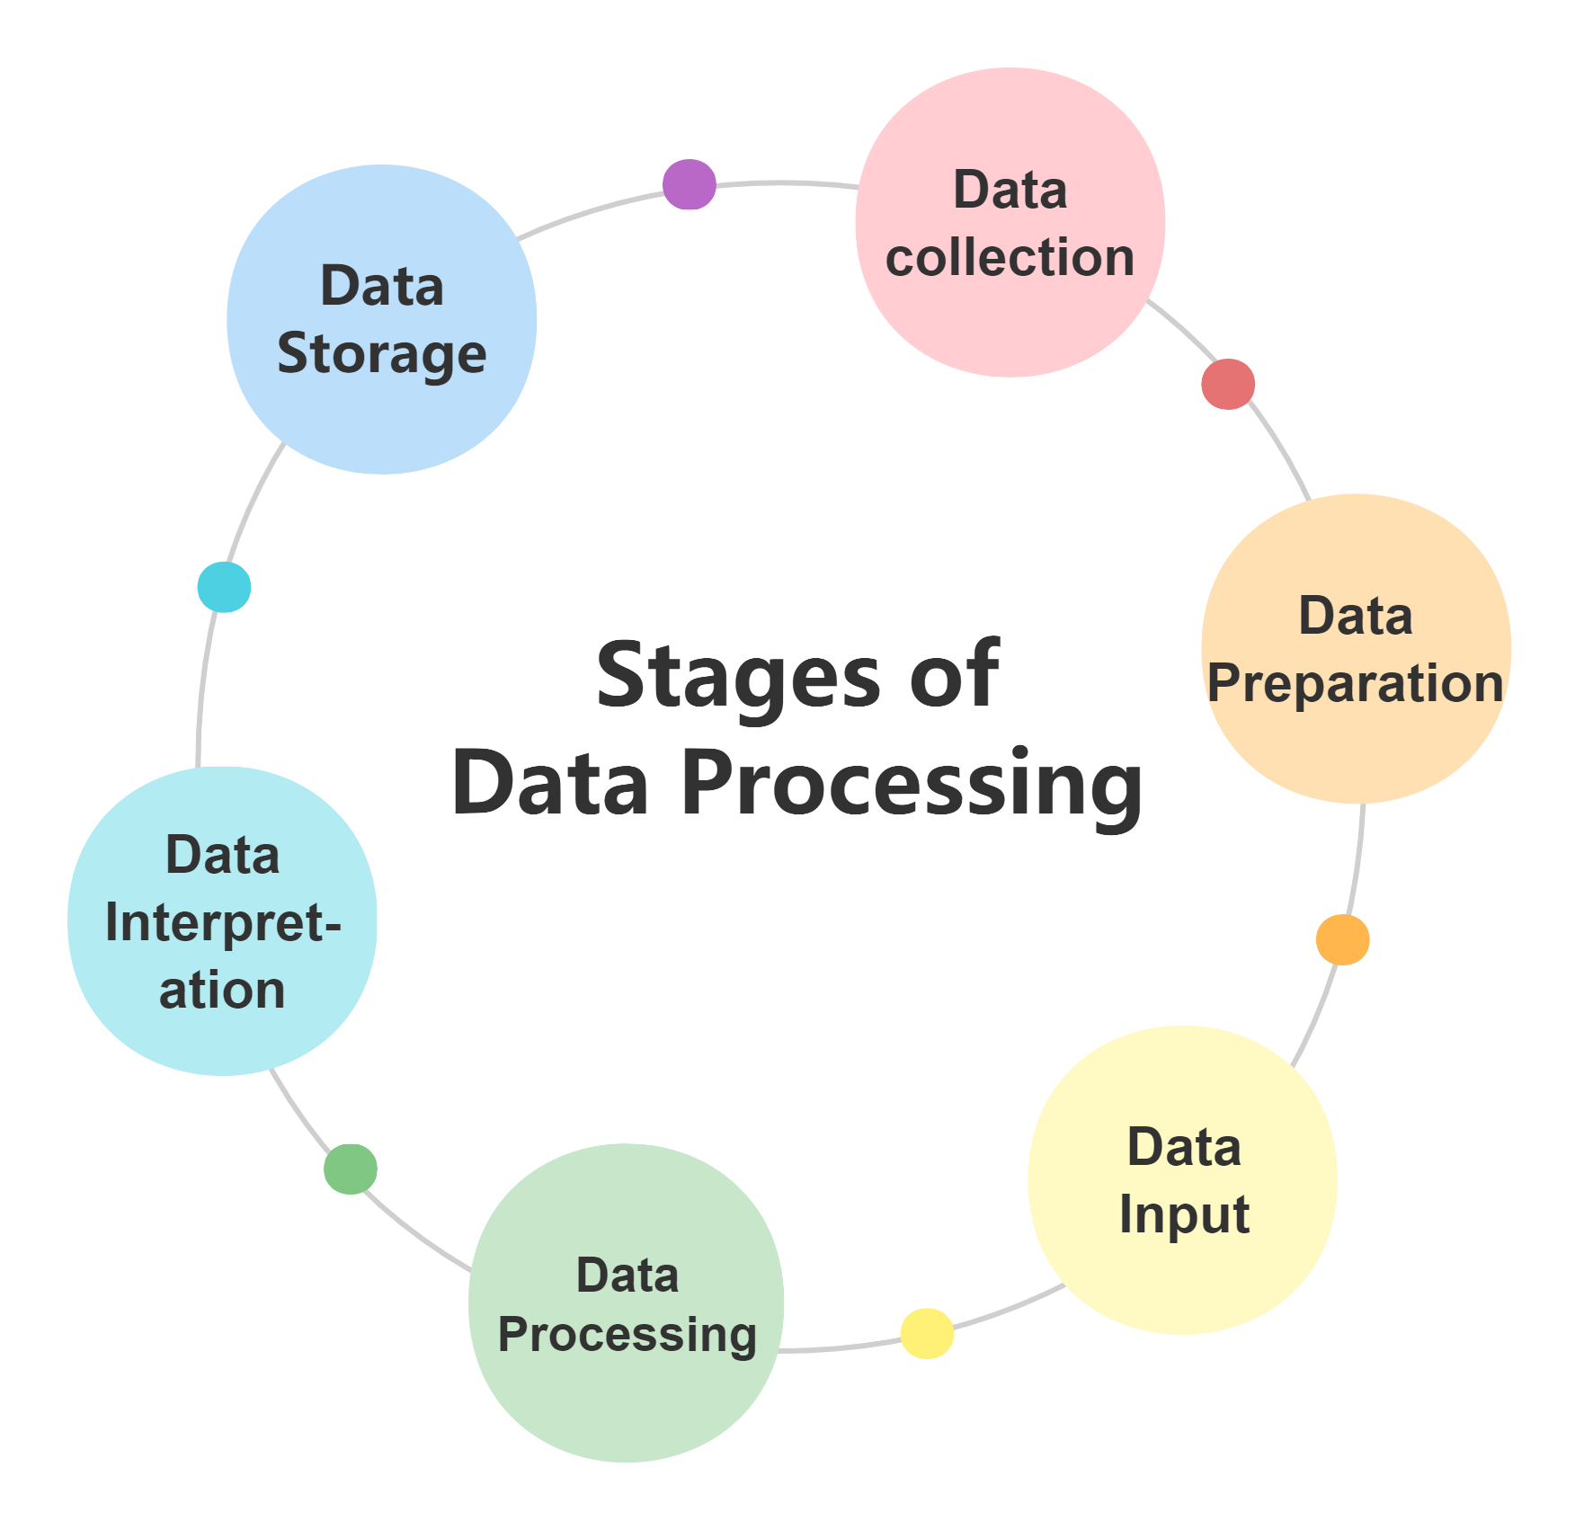
Data Pre-processing
Convert date column to DateTime format.
Extract time-based features: Hour, Day, Month, Weekday, Weekend Indicator
Feature Engineering:
Sinusoidal encoding of hour (hour_sin, hour_cos)
Temperature-Humidity Ratio
Outdoor Temperature Variation
Pressure-Humidity Interaction
Scaling: StandardScaler applied to numerical features.

Slide 8
Exploratory Data Analysis (EDA)
What is EDA?
EDA is the initial phase of data analysis.
It's about examining and understanding your data before diving into modeling.
Basic Statistics
Utilize basic statistics to summarize data.
Key stats include mean, median, and standard deviation.
Data Summary
Summarize the main characteristics of the data.
Identify patterns, anomalies, and insights.
Importance of EDA
EDA helps identify data trends, issues, and outliers.
It guides data preprocessing and feature selection.
A crucial step before building predictive models.

Slide 9
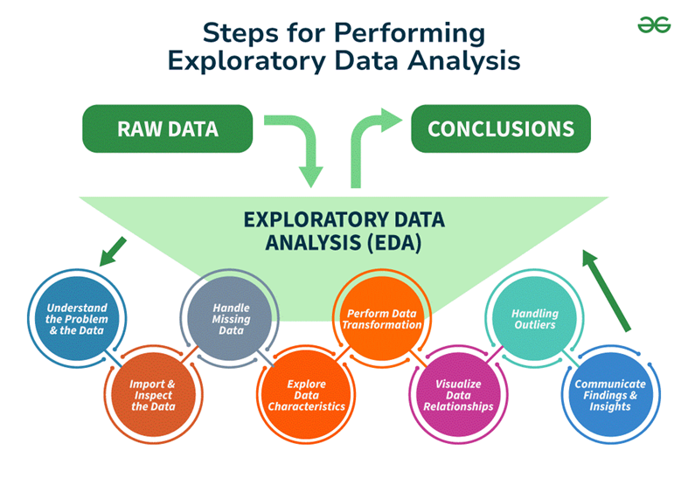
Exploratory Data Analysis (EDA)
Data Distribution: Histogram of Appliance Energy Consumption.
Correlation Analysis: Heatmap to visualize feature relationships.
Observations: Some features show strong correlation with energy consumption.

Slide 10
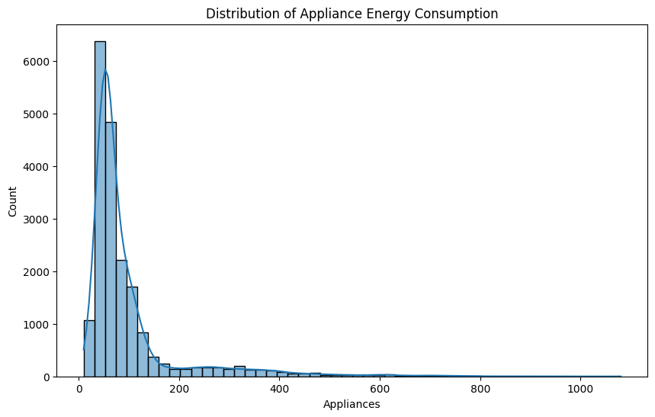
Exploratory Data Analysis (EDA)

Slide 11
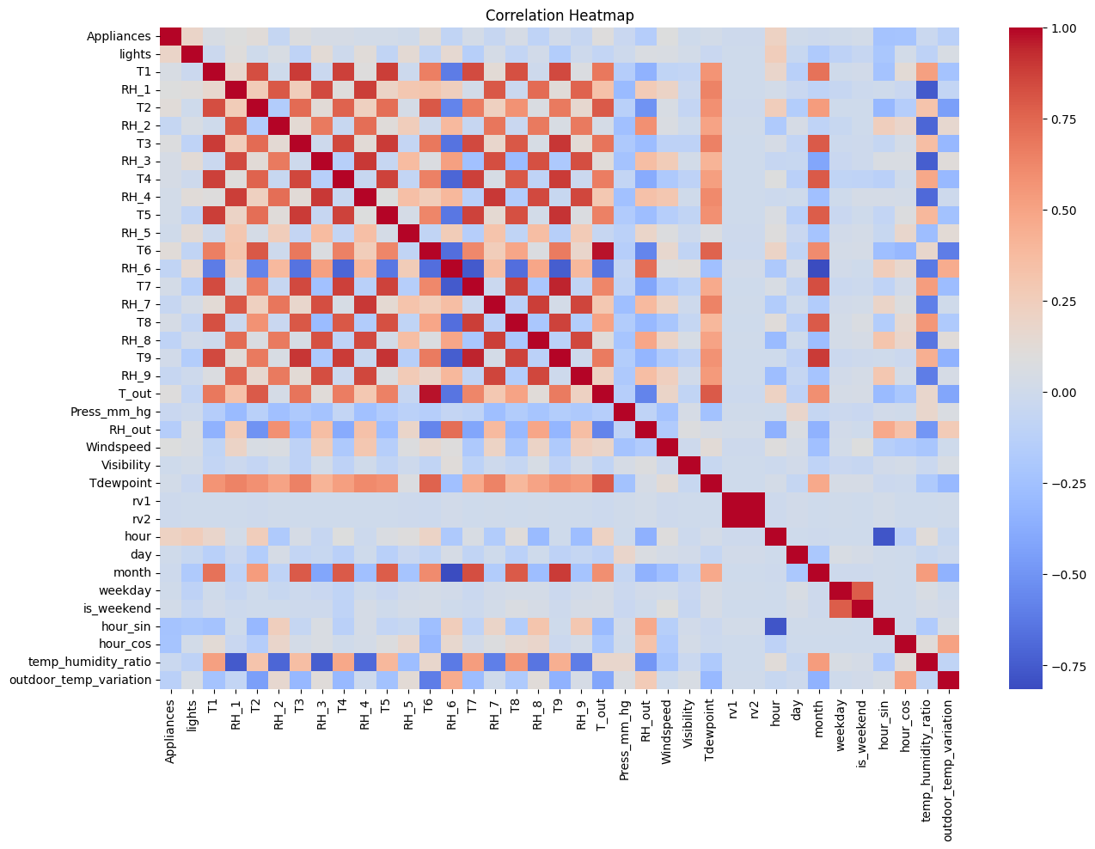
Exploratory Data Analysis (EDA)

Slide 12
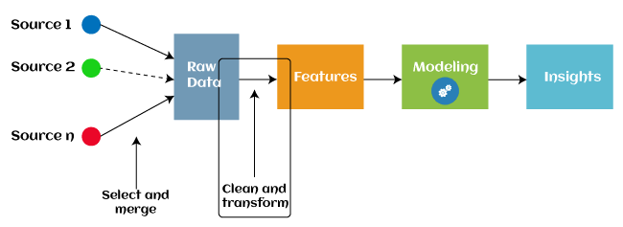
Feature Engineering
Criteria: Features with absolute correlation > 0.05 with target variable.
Features Selected: Includes temperature, humidity, and engineered features.

Slide 13

Machine Learning Model Development
Choosing a Machine Learning Algorithm: Selected the right algorithm (e.g., Linear Regression, Random Forest Regressor) for our problem.
Training and Evaluating the Model: Covered the process of training and evaluating the model to ensure its robust and reliable.
Model Evaluation Metrics: Used metrics like accuracy, precision, and recall to assess how well the model is performing.

Slide 14
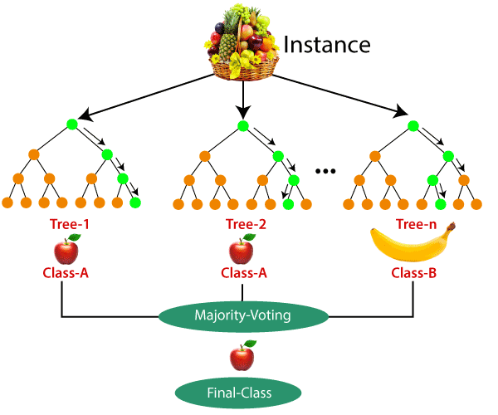
Model Training & Selection
Models Used:
Linear Regression (Baseline)
Random Forest Regressor (Ensemble Learning)
Gradient Boosting Regressor (Boosting)
XGBoost Regressor (Optimized Boosting)
Voting Regressor (Ensemble of Best Models)
Deep Neural Network (Multi-Layer Perceptron)

Slide 15
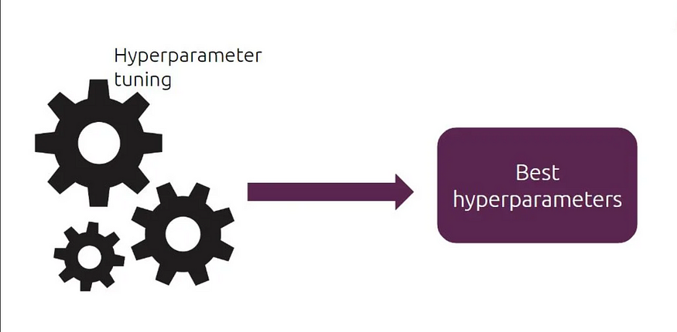
Hyperparameter Tuning
Random Forest: GridSearchCV for n_estimators, max_depth, min_samples_split, min_samples_leaf
Gradient Boosting & XGBoost: Tuned n_estimators, learning_rate, max_depth
Neural Network: 3 Hidden Layers, Dropout for Regularization, Adam Optimizer

Slide 16
Model Evaluation & Results
Model | MSE | R² Score
Optimized Random Forest | 4405.10 | 0.5598
Gradient Boosting | 5744.58 | 0.4259
XGBoost | 5264.73 | 0.4739
Ensemble Model | 4906.55 | 0.5096
Neural Network | 6438.02 | 0.3566
Best Performing Model: Random Forest (R² = 0.5598)
Ensemble Model also performed well (R² = 0.5096).

Slide 17
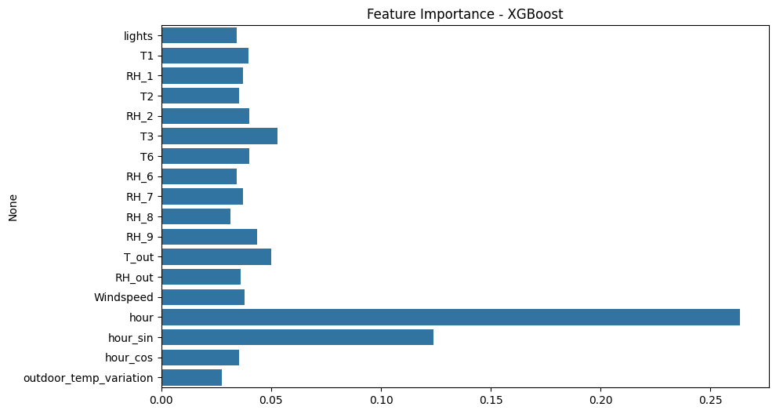
Feature Importance Analysis
Top Features:
Outdoor Temperature Variation
Temperature-Humidity Ratio
Hour of the Day (Encoded)
Insights: Temperature and humidity play a crucial role in energy consumption.

Slide 18
Conclusion & Future Work
Key Takeaways:
Feature engineering improved model performance.
Random Forest and Ensemble models performed best.
Neural Network underperformed; needs further tuning.
Next Steps:
Test additional ensemble techniques (Stacking, Blending).
Explore LSTMs for time-series dependencies.
Integrate real-time forecasting for smart home applications.

Slide 19
Thank You!

